Slide 1
Science with Dr. Christina Rahm We will get started shortly.

Slide 2
Medical Disclaimer:
The information provided is for educational purposes and is not intended as medical advice, or a substitute for the medical advice of a physician or other qualified health care professional. This is for science and educational purposes only and cannot be used in any aspect for sales or marketing. You should not use this information for diagnosing a health or fitness problem or disease. You should always consult with a doctor or other health care professional for medical advice or information about diagnosis and treatment. This is Confidential. Do not distribute—for scientific educational purposes only.
Notes:
The information provided is for educational purposes and is not intended as medical advice, or a substitute for the medical advice of a physician or other qualified health care professional. This is for science and educational purposes only and cannot be used in any aspect for sales or marketing. You should not use this information for diagnosing a health or fitness problem or disease. You should always consult with a doctor or other health care professional for medical advice or information about diagnosis and treatment. This is Confidential. Do not distribute—for scientific educational purposes only.

Slide 3
Dr. Christina Rahm CEO & Chief Science Officer

Slide 4
ISNS Case Study Presented by: Dr. Christina Rahm

Slide 5
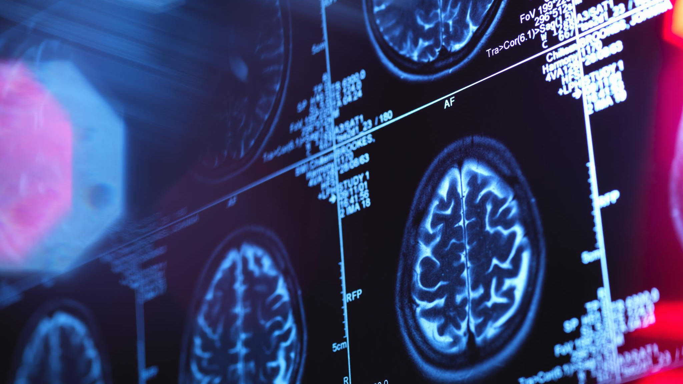
NEURODEGENERATIVE DISEASES
Parkinson’s Disease, Alzheimer’s Disease, and ALS

Slide 6
Neurodegenerative Diseases
Neurodegenerative diseases occur when nerve cells in the brain or peripheral nervous system lose function over time and ultimately die. Alzheimer’s disease and Parkinson’s disease are the most common neurodegenerative diseases. Degenerative nerve diseases affect many of your body's activities, such as balance, movement, talking, breathing, and heart function.
These diseases are often genetic, but sometimes the cause is a medical condition such as alcoholism, a tumor, or stroke. Other causes may include toxins, chemicals, viruses, or lack of vital minerals. It depends on the type of disease, but most of them, such as Parkinson’s and Alzheimer’s, have no cure.

Slide 7
Parkinson's disease is a brain disorder that leads to shaking, stiffness, and difficulty with walking, balance, and coordination.
ALS or Amyotrophic lateral sclerosis is a progressive nervous system disease that affects nerve cells in the brain and spinal cord, causing loss of muscle control.
Alzheimer’s disease is a brain disorder that slowly destroys memory and thinking skills, and, eventually, the ability to carry out the simplest tasks. It is the cause of 60-70% of cases of dementia.

Slide 8
Possible Causes & Triggers of Neurodegenerative Diseases
Environmental Toxin Exposure:
Tumor/Cancer:
Mineral Deficiency:
Viruses: Viruses that attack the human immune system can also affect the nervous system and interfere with classical pathways of neurodegenerative diseases.

Slide 9
Environmental pollutants as risk factors for neurodegenerative disorders: Alzheimer and Parkinson diseases By Miguel Chin-Chan, Juliana Navarro-Yepes, and Betzabet Quintanilla-Vega
Neurotoxic metals such as lead, mercury, aluminum, cadmium and arsenic, as well as some pesticides and metal-based nanoparticles have been involved in Alzheimer’s disease (AD) due to their ability to increase beta-amyloid (Aβ) peptide and the phosphorylation of Tau protein (P-Tau), causing senile/amyloid plaques and neurofibrillary tangles (NFTs) characteristic of AD.
Exposure to lead, manganese, solvents, and some pesticides has been related to hallmarks of Parkinson’s disease (PD) such as mitochondrial dysfunction, altercations in metal homeostasis and aggregation of proteins such as α-synuclein (α-syn), which is a key constituent of Lewy bodies (LB), a crucial factor in PD pathogenesis.
A recent study showed that acute lead exposure (27 mg/kg) to APP transgenic mice reduced the expression of LRP1, resulting in the accumulation of Aβ in the hippocampus and cortex of treated mice.
A study has reported increased levels of mercury and bromide in the brain, and reduced levels of rubidium, selenium, and and zinc in AD brains compared with controls. In addition, it was reported there was more than a 2-fold increase in blood Hg levels in AD patients compared with a control group.
https://www.ncbi.nlm.nih.gov/labs/pmc/articles/PMC4392704/

Slide 10
Viruses and Neurodegeneration By Li Zhou, Monica Miranda-Saksena & Nitin K Saksena
Viruses can induce altercations and degenerations of neurons in the brain. They have the ability to attack the host immune system, affecting areas of nervous tissues that can interfere with the same pathways involved in Neurodegenerative diseases.
Viral antigens preferentially activate TLRs 3, 7 and 8 are driving innate and adaptive immune responses and leading to neuronal damage, which occurs through direct damage, killing, release of free radicals, cellular activation and inflammation.
In a study, researchers demonstrated the role of HSV-1 in AD by localizing HSV-1 DNA in amyloid plaques and detected higher association between viral DNA and Amyloid beta plaques in AD patients’ brains compared to normal ageing brains, suggesting HSV-1 to be a possible major cause of amyloid plaques and a possible etiological factor in AD.
https://virologyj.biomedcentral.com/articles/10.1186/1743-422X-10-172

Slide 11
The Effect of Magnesium Deficiency of Neurological Disorders: A Narrative Review Article By Wenwen XUE, Jing YOU, Yingchao SU, and Qinglu WANG
Recent studies have associated Mg-deficiency with many neurological disorders, such as cerebral vasospasm, Alzheimer’s disease, Parkinson’s disease, stroke, and migraine.
Decreased Mg level was found in various tissues of AD patients in both clinical and laboratory studies
The level of Mg diet is critical to maintain synaptic plasticity, and the decline in hippocampal synaptic connections has been associated with impaired memory
An experiment showed the concentration of magnesium in the cortex, white matter, basal ganglia and brainstem of PD brain is low
https://www.ncbi.nlm.nih.gov/labs/pmc/articles/PMC6570791/

Slide 12
PROPRIETARY BLENDS LEGEND
Proprietary blend I: Silica, Vitamin C, and Trace Minerals
Proprietary blend II: N-acetyl L-tyrosine, Anhydrous Caffeine, L-theanine, Velvet Bean Seed, Pine Bark, Curcumin, and Vitamin D
Proprietary blend III: Black seed oil, Resveratrol, turmeric, Raspberry Ketones, Apple Cider Vinegar, Aloe Vera, and D-Ribose
International Science and Nutrition Society – CURARE CAUSAM – ISNS 2021

Slide 13
ISNS CASE STUDY I
Patient: Male
Age: 63-year-old
History: A 63-year-old male diagnosed with Parkinson’s disease around 3 years ago. His medication consists of levodopa/benserazide 200 mg/50 mg.
Treatment/ Method: He started on 1 capsule of Proprietary blend 2, 1 in the morning and 1 in the afternoon for 10 days; he then increased to 2 in the morning and 1 in the afternoon. He added 1 packet of Proprietary blend 3 to his diet, 1 in the morning. He also started taking 2 x 6 drops of Proprietary blend 1, once in the morning and once at night, for 3 days; he then increased by 1 -1 drops every 3 days to 2 x 10.
Results: After 1 month, the three cardinal symptoms of Parkinson’s Disease, resting tremor, rigidity (muscle stiffness), and bradykinesia (slowing down), all significantly decreased. In addition, his quality of sleep improved as well as gait. His medications have not changed.
International Science and Nutrition Society – CURARE CAUSAM – ISNS 2021

Slide 14
Critical Review on Zeolite Clinoptilolite Safety and Medical Applications in vivo By Sandra Kraljević Pavelić, Jasmina Simović Medica, Darko Gumbarević, Ana Filošević, Nataša Pržulj and Krešimir Pavelić
A clinoptilolite sorbent KLS-10-MA decreased the lead accumulation in the intestine by more than 70% in lead-intoxicated mice.
Antiviral properties for clinoptilolite in vitro were demonstrated on the human adenovirus 5, herpes simplex virus type 1, and the human enteroviruses coxsackievirus B5 and echovirus 7.
One study involving patients treated with tribomechanically micronized clinoptilolite showed a significant increase in specific immunity cell counts, T-helper cells CD4+, and activated T-lymphocytes HLA-DR+ followed with a decreased natural immunity NK CD56+ cell counts.
https://www.frontiersin.org/articles/10.3389/fphar.2018.01350/full

Slide 15
Mucuna Pruriens in Parkinson’s Disease By Roberto Cilia, MD,corresponding author Janeth Laguna, MD, Erica Cassani, MD, Emanuele Cereda, MD, PhD, Nicolò G. Pozzi, MD, Ioannis U. Isaias, MD, PhD, Manuela Contin, PharmD, Michela Barichella, MD, and Gianni Pezzoli, MD
Objective: In this study, it was investigated whether Mucuna pruriens may be used as an alternative source of L-DOPA for individuals with Parkinson’s Disease who can not afford long-term therapy.
Method: Eighteen patients with advanced PD received the following treatments, whose sequence was randomized: (1) dispersible levodopa at 3.5 mg/kg combined with the dopa-decarboxylase inhibitor benserazide (LD+DDCI; the reference treatment); (2) high-dose Mucuna pruriens (MP-Hd; 17.5 mg/kg); (3) low-dose Mucuna pruriens (MP-Ld; 12.5 mg/kg); (4) pharmaceutical preparation of LD without DDCI (LD−DDCI; 17.5 mg/kg); (5) Mucuna pruriens plus benserazide (MP+DDCI; 3.5 mg/kg); (6) placebo.
Results: When compared to LD+DDCI, Mucuna pruriens-levodopa showed similar motor response with fewer dyskinesias and AEs, while Mucuna pruriens-high dose induced greater motor improvement at 90 and 180 minutes, longer ON duration, and fewer dyskinesias.
https://www.ncbi.nlm.nih.gov/labs/pmc/articles/PMC5539737/

Slide 16
References
https://www.niehs.nih.gov/research/supported/health/neurodegenerative/index.cfm
https://www.mayoclinic.org/diseases-conditions/amyotrophic-lateral-sclerosis/symptoms-causes/syc-20354022
https://www.mayoclinic.org/diseases-conditions/parkinsons-disease/symptoms-causes/syc-20376055

Slide 17
Thank you for joining us today!

